Slide 1
Machine Learning Models and Dataset Versioning
1

Slide 2
$ whoami
Open source contributor DVC, CloudCV.
FOSSASIA OpenTechNights Winner
ML intern @Neuroplex
ML and AI enthusiast
Final year BTech student @ MEC
2

Slide 3
Outline
Why ML is different from software eng?
Problems on using git and git-LFS
Tools for versioning
Why DVC is a good option
Use case: Versioning Cats vs Dogs
3

Slide 4
What is ML?
It provides an systems the ability to automatically learn and improve from experience without being explicitly programmed.
Prerequisities
4

Slide 5
How ML is different?
Data science as different from software
as software was different from hardware.
                - Nick Elprin, CEO Domino Labs
The rise of Software engineering required inventing new processes like version control, code review, agile, to help teams work effectively. The rise of AI & Machine Learning is now requiring new processes, ..
- Andrew Ng
5

Slide 6
Key Differences
ML is metrics driven
Enormous size of data and models
Sharing of Models with teams
Pipelines
Special purpose hardware
Difference in best practises
6

Slide 7
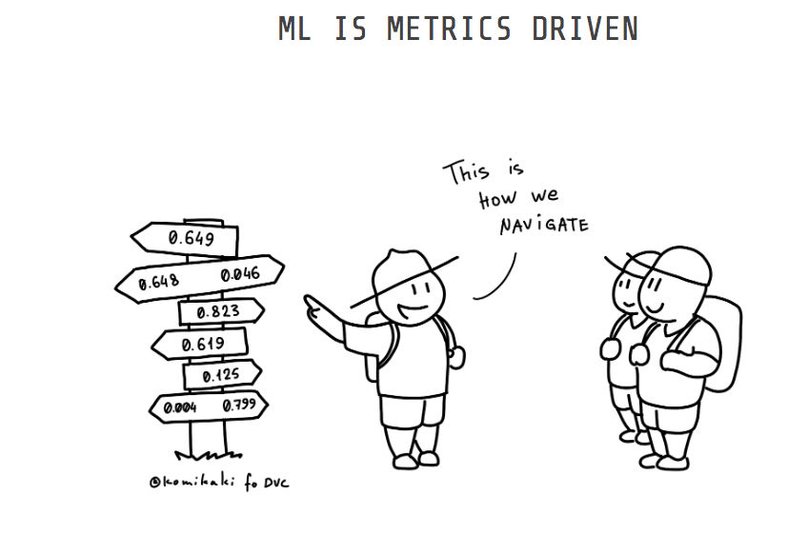
ML is metric driven
We focus on improving metrics like accuracy, AUC, ROC, Root mean sqare error.
7

Slide 8
Feature-driven Development
While in software engineering, your team works by building new features.
Use code-review and agile best practises.
8

Slide 9
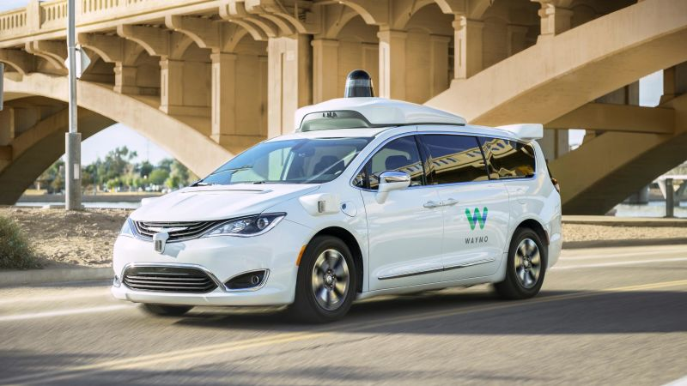
Huge amount of Data dealed
People work with lots of data for everything.
Managing datasets are a problem
Models – a byproduct :P
9

Slide 10
Huge amount of Data dealed
People work with TB’s of data for everything.
Managing datasets are a problem
amount of data generated for a self-driving car
(~4 TB/day)
10

Slide 11
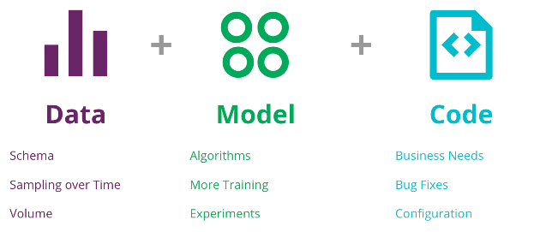
Sharing of Models with Team
Most software product take a few minutes to run, which team can easily follow.
Collabrative challenges faced when working with large teams and remotely.
11

Slide 12
Pipelines of different stages
Defining process of steps at each duration like:
- Input
- Feature extraction
- Classification
- Final output
12

Slide 13
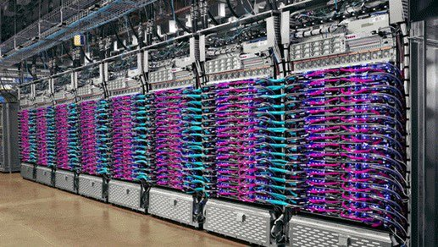
Special purpose hardwares
Use of special TPUs
Cloud platforms(GCP, azure, AWS, ....)
ML researchers have huge computation needs
13

Slide 14
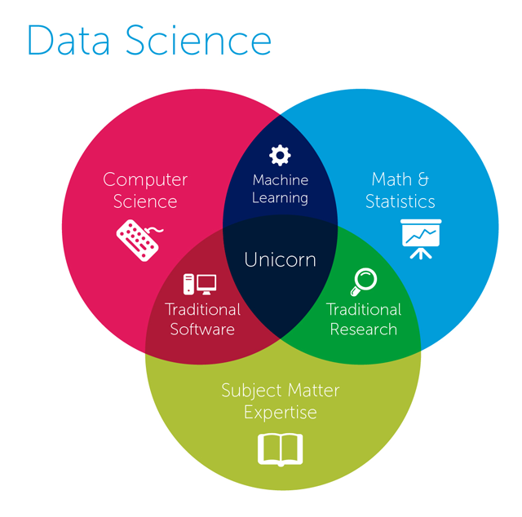
Difference in best practises
Use of Python PEP8 conventions are not always properly practised in jupyter notebooks.
DataScience = software eng + science&maths
from fastai import *
14

Slide 15

Using git for large dataset
Trying git for dataset of size of 1GB takes about 8-10 minutes to commit
.gitignore – ignores Dataset versioning
15

Slide 16
Using git-LFS
“Git Large File Storage (LFS) replaces large files such as audio samples, videos, datasets, and graphics with text pointers inside Git, while storing the file contents on a remote server like GitHub.com or GitHub Enterprise.”
16

Slide 17
Limitations of git-LFS
There is a data limit of storing files of 2GB.
No support for cloud storage platforms(AWS, GCP,..)
Not designed in mind with ML/data science
17

Slide 18
Other open source tools
Data Version Control – Track experiments, data
ML flow – Metric Tracking, Model Deployment
Neptune.ml – Experiment Tracking, collabration
Jovian – Share notebooks, easily reproducible
hangar py – Version control for tensor data
18

Slide 19
Why DVC is a good option?
It’s open source
Has support for multiple cloud providers
Support for:
a) Pipelines
b) Versioning ML models
c) Versioning Datasets
d) Tracking metrics
“Made for Data scientist, by the Data scientist”
19

Slide 20
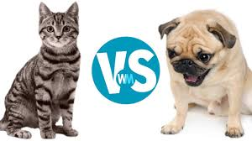
Using DVC with a problem
We are going to work on a Classic Deep Learning problem like cats vs dogs:
# initialising project
$ git clone https://github.com/iterative/example-versioning.git
$ cd example-versioning
20

Slide 21
1. Add the data to dvc
We use 1000 labelled images of Cats and dogs at first
$ dvc add data Add datafolder to dvc
$ python train.py
$ dvc add model.h5 model is add to dvc
21

Slide 22
2. Track changes with git
$ git add .gitignore model.h5.dvc data.dvc metrics.json
$ git commit -m "First model, trained with 1000 images"
$ git tag -a "v1.0" -m "model v1.0, 1000 images"
22

Slide 23
3. Push changes to cloud
$ dvc push
$ dvc pull
Data is pushed to remote server from local cache.
DVC is storage agnostic and support s3, Azure, GCP, hdfs, ssh
23

Slide 24
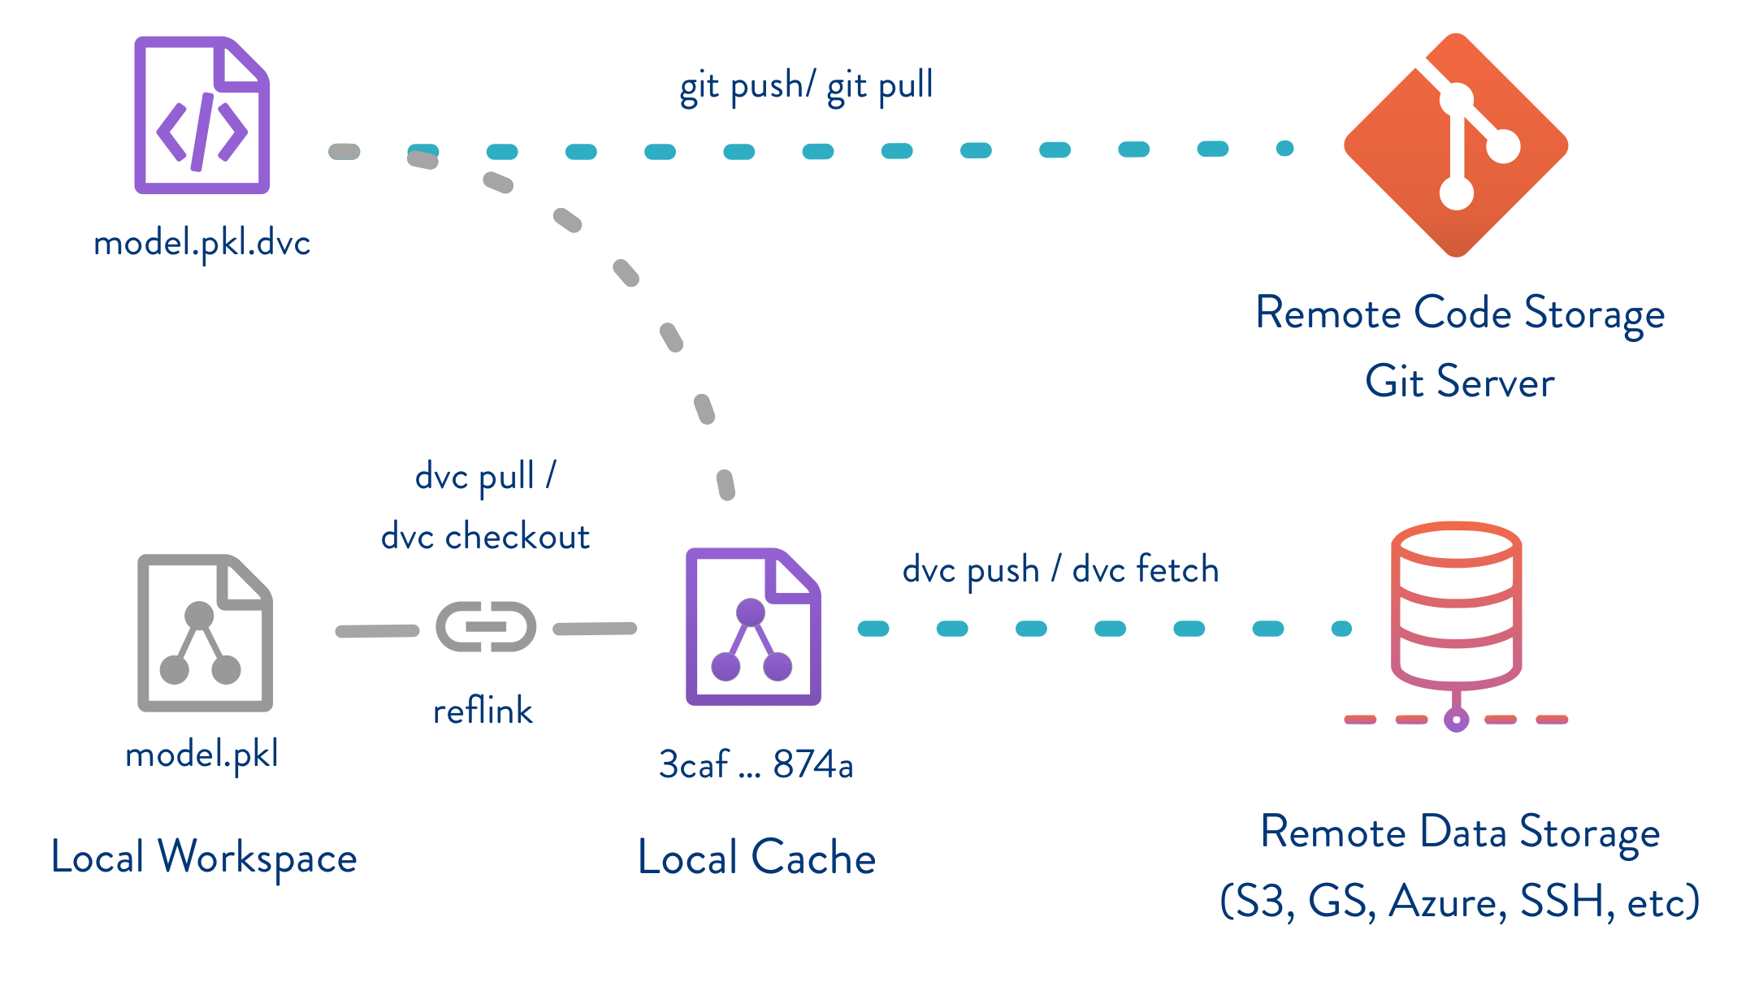
24

Slide 25
4. Adding more labelled data
(downloading 1000 more images of labelled cat and dog images)
$ dvc add more_data
$ dvc remove model.h5.dvc
$ python train.py
$ dvc add model.h5
25

Slide 26
$ git add model.h5.dvc data.dvc metrics.json
$ git commit -m "Second model, trained with 2000 images"
$ git tag -a "v2.0" -m "model v2.0, 2000 images"
26

Slide 27
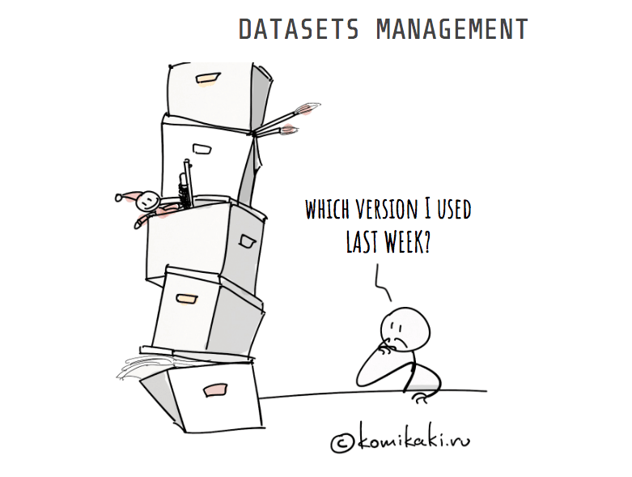
What is Dataset versioning?
Tracking of data at each time
When working with TB’s of data it’s essential
Different splits for train/test/val
27

Slide 28
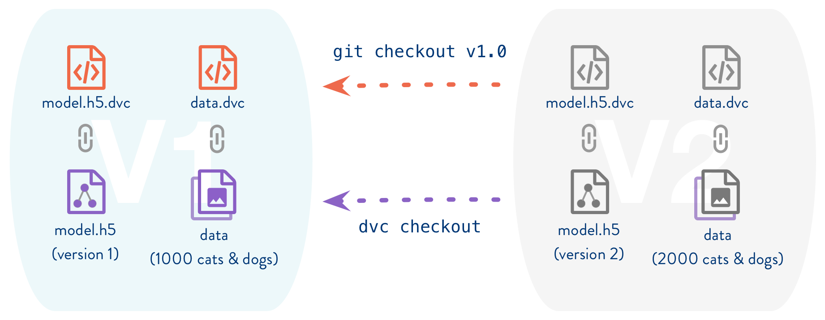
5. Switching between versions
$ git checkout v1.0
$ dvc checkout
28

Slide 29
6. Running experiments
$ dvc pull data_folder.dvc
$ dvc run <parameters>
DVC is internally building a dependency graph using dependencies, output and stores the result.
29

Slide 30
dvc run -f modelDvcfile \
-d train.py -d data \
-M metrics.json \
-o model.h5 \
-o bottleneck_features_train.npy \
python train.py
30

Slide 31
d for dependency: specify an input file
o for output: specify an output file ignored by git and tracked by dvc
M for metric: specify an output file tracked by git
f for file: specify the name of the dvc file.
31

Slide 32
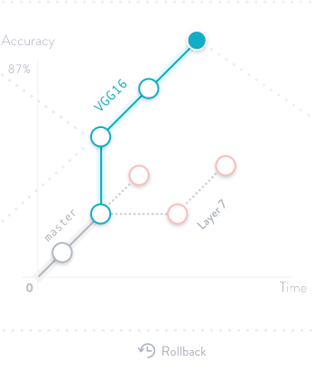
7. More Experiments
I use VGG architecture for version1
Then resnet for version2
V2 made much more improvements by using Bottle-necks
Fine tune models
33

Slide 33
Model versioning
Models = Code + data + hyperparameters
Everytime our hyperparameters are changed, we can have corresponding DVC files with store the changes
You can even reproduce the old results
32

Slide 34
8. Iterating over experiments
$ dvc repro train_v2.dvc
$ dvc metrics show
34

Slide 35
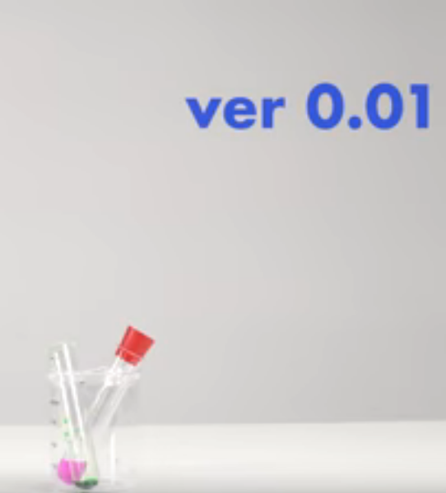
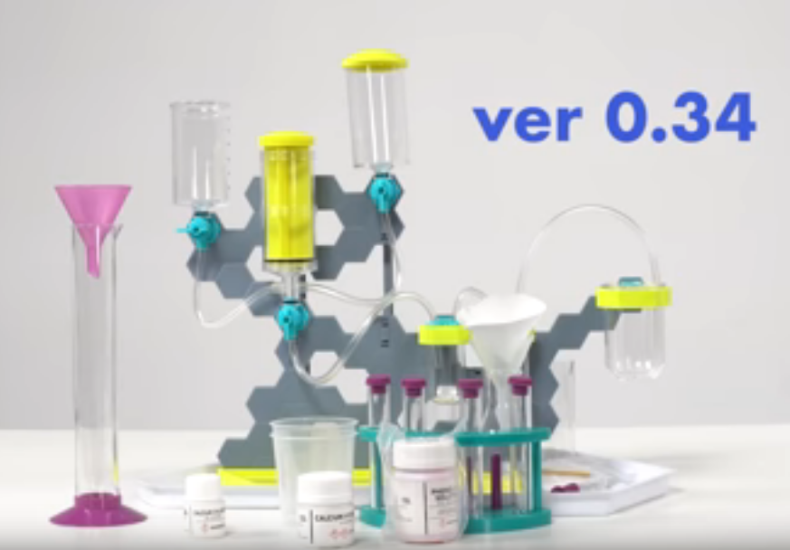
ML Reproducibilty crisis
Much of ML projects are not reproducible
Managing the metrics and hyperparameters which changed this module is very important
35

Slide 36
Thank You
36

